Slide 1


ESSAY Question #4 ~ Social Media for eCommerce
CIS 234E
Electronic Commerce
Website
Your Student ID
your email address
Email to “DrV”
ProfessorVillegas@gmail.com
Place your pix above
And name below
Page 1
CIS 234E ~ ELECTRONIC COMMERCE WEBSITE * YOUR FULL NAME + Phone Number

Slide 2
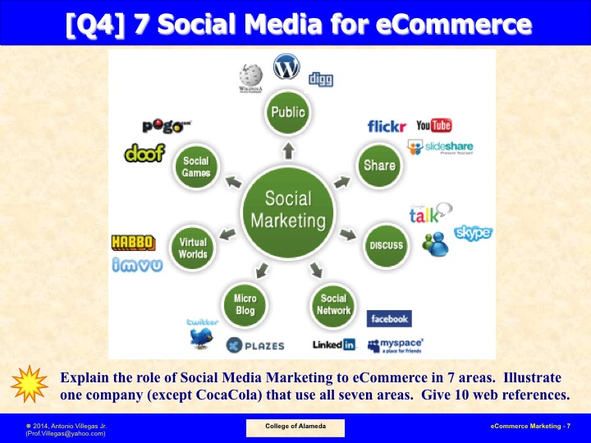
Page 2
CIS 234E ~ ELECTRONIC COMMERCE WEBSITE * YOUR FULL NAME + Phone Number

Slide 3
ESSAY Question 4 ~ Social Media + eCommerce Defined
What’s Social Media?
What’s eCommerce?
How can they merge?
Place pictures depicting your answers above + short description here
Page 3
CIS 234E ~ ELECTRONIC COMMERCE WEBSITE * YOUR FULL NAME + Phone Number

Slide 4
ESSAY Question 4 ~ Social E-Commerce ~ PUBLIC (Example 1)
In very few words
Explain the
PUBLIC aspect
of Social eCommerce
And show how
Company 1 uses this
For example
Place a picture depicting your answer above + short description here
Page 4
CIS 234E ~ ELECTRONIC COMMERCE WEBSITE * YOUR FULL NAME + Phone Number

Slide 5
ESSAY Question 4 ~ Social E-Commerce ~ PUBLIC (Example 2)
In very few words
Explain the
PUBLIC aspect
of Social eCommerce
And show how
Company 2 uses this
For example
Place a picture depicting your answer above + short description here
Page 5
CIS 234E ~ ELECTRONIC COMMERCE WEBSITE * YOUR FULL NAME + Phone Number

Slide 6
ESSAY Question 4 ~ Social E-Commerce ~ SHARE (Example 1)
In very few words
Explain the
SHARE aspect
of Social eCommerce
And show how
Company 1 uses this
For example
Place a picture depicting your answer above + short description here
Page 6
CIS 234E ~ ELECTRONIC COMMERCE WEBSITE * YOUR FULL NAME + Phone Number

Slide 7
ESSAY Question 4 ~ Social E-Commerce ~ SHARE (Example 2)
In very few words
Explain the
SHARE aspect
of Social eCommerce
And show how
Company 2 uses this
For example
Place a picture depicting your answer above + short description here
Page 7
CIS 234E ~ ELECTRONIC COMMERCE WEBSITE * YOUR FULL NAME + Phone Number

Slide 8
ESSAY Question 4 ~ Social E-Commerce ~ DISCUSS (Example 1)
In very few words
Explain the
DISCUSS aspect
of Social eCommerce
And show how
Company 1 uses this
For example
Place a picture depicting your answer above + short description here
Page 8
CIS 234E ~ ELECTRONIC COMMERCE WEBSITE * YOUR FULL NAME + Phone Number

Slide 9
ESSAY Question 4 ~ Social E-Commerce ~ DISCUSS (Example 2)
In very few words
Explain the
DISCUSS aspect
of Social eCommerce
And show how
Company 2 uses this
For example
Place a picture depicting your answer above + short description here
Page 9
CIS 234E ~ ELECTRONIC COMMERCE WEBSITE * YOUR FULL NAME + Phone Number

Slide 10
ESSAY Question 4 ~ Social E-Commerce ~ NETWORK (Example 1)
In very few words
Explain the
SOCIAL NETWORK aspect
of Social eCommerce
And show how
Company 1 uses this
For example
Place a picture depicting your answer above + short description here
Page 10
CIS 234E ~ ELECTRONIC COMMERCE WEBSITE * YOUR FULL NAME + Phone Number

Slide 11
ESSAY Question 4 ~ Social E-Commerce ~ NETWORK (Example 2)
In very few words
Explain the
SOCIAL NETWORK aspect
of Social eCommerce
And show how
Company 2 uses this
For example
Place a picture depicting your answer above + short description here
Page 11
CIS 234E ~ ELECTRONIC COMMERCE WEBSITE * YOUR FULL NAME + Phone Number

Slide 12
ESSAY Question 4 ~ Social E-Commerce ~ MICRO BLOG (Example 1)
In very few words
Explain the
MICRO BLOG aspect
of Social eCommerce
And show how
Company 1 uses this
For example
Place a picture depicting your answer above + short description here
Page 12
CIS 234E ~ ELECTRONIC COMMERCE WEBSITE * YOUR FULL NAME + Phone Number

Slide 13
ESSAY Question 4 ~ Social E-Commerce ~ MICRO BLOG (Example 2)
In very few words
Explain the
MICRO BLOG aspect
of Social eCommerce
And show how
Company 2 uses this
For example
Place a picture depicting your answer above + short description here
Page 13
CIS 234E ~ ELECTRONIC COMMERCE WEBSITE * YOUR FULL NAME + Phone Number

Slide 14
ESSAY Question 4 ~ Social E-Commerce ~ VIRTUAL WORLDS (Example 1)
In very few words
Explain the
VIRTUAL WORLDS aspect
of Social eCommerce
And show how
Company 1 uses this
For example
Place a picture depicting your answer above + short description here
Page 14
CIS 234E ~ ELECTRONIC COMMERCE WEBSITE * YOUR FULL NAME + Phone Number

Slide 15
ESSAY Question 4 ~ Social E-Commerce ~ VIRTUAL WORLDS (Example 2)
In very few words
Explain the
VIRTUAL WORLDS aspect
of Social eCommerce
And show how
Company 2 uses this
For example
Place a picture depicting your answer above + short description here
Page 15
CIS 234E ~ ELECTRONIC COMMERCE WEBSITE * YOUR FULL NAME + Phone Number

Slide 16
ESSAY Question 4 ~ Social E-Commerce ~ SOCIAL GAMES (Example 1)
In very few words
Explain the
SOCIAL GAMES aspect
of Social eCommerce
And show how
Company 1 uses this
For example
Place a picture depicting your answer above + short description here
Page 16
CIS 234E ~ ELECTRONIC COMMERCE WEBSITE * YOUR FULL NAME + Phone Number

Slide 17
ESSAY Question 4 ~ Social E-Commerce ~ SOCIAL GAMES (Example 2)
In very few words
Explain the
SOCIAL GAMES aspect
of Social eCommerce
And show how
Company 2 uses this
For example
Place a picture depicting your answer above + short description here
Page 17
CIS 234E ~ ELECTRONIC COMMERCE WEBSITE * YOUR FULL NAME + Phone Number

Slide 18
ESSAY Question 4 ~ Summary of your Answers
Public
Share
Discuss
Social Network
Micro Blog
Virtual Worlds
Social Games
Show picture of a Company that employs the 7 aspects excluding Coca Cola.
Briefly explain how!
Page 18
CIS 234E ~ ELECTRONIC COMMERCE WEBSITE * YOUR FULL NAME + Phone Number

Slide 19
ESSAY Question 4 ~ Bibliographical References
Use MLA Citation for your Bibliography entries
~ go to this website for help
➔ https://www.refme.com/us/citation-generator/mla/
Page 19
CIS 234E ~ ELECTRONIC COMMERCE WEBSITE * YOUR FULL NAME + Phone Number

